Slide 1


IDTE
INNOVATION
DRIVE
TECHNOLOGY
EXPO
RESEARCH &
ADVANCED ENGINEERING
ACM YPSILANTI, MICHIGAN
AUGUST 22 – 24 & 27-28, 2018

Slide 2
IDTE
TABLE OF CONTENTS
GENERAL EVENT OVERVIEW
2017 video
Overview
Evaluators Routine
Key Dates
SETUP INFORMATION
General info
INFO REQUIRED by Aug 1st
Shipping information
Info needed from supporters
What ACM will provide
Static layout
Required driveable forms
EV Charging
Driveable layouts
DRY RUN INFORMATION
Parking
Registration
Detailed Agenda
EVENT WEEK INFORMATION
Registration & Badges
Detailed Supporter Agenda
Detailed Evaluator Agenda
GENERAL SUPPORTER INFORMATION
Event Reminders
Things to Do
Emergency Procedure
Medical Emergency Procedure
FAQS
IDTE CENTRAL PLANNERS

Slide 3
IDTE
EVENT OVERVIEW
Purpose: Showcasing customer relevant technologies and provide our Ford Executive teams an opportunity to experience and evaluate new and relevant technologies.
Experience: Evaluators are given a personalized agenda. Each technology is experienced in a 20 minute demonstration. This may be in a vehicle testing new electrified solutions, a new self-parking feature, or inside experiencing a virtual mobility solution, or watching a new 3D Printing concept in action.
After each experience, a questionnaire is completed, providing feedback on the technology.
Details: Technologies & concepts are showcased by Ford R&A (Dearborn, Palo Alto, & Aachen) and PD, GFL, FordPass, Startups, Universities & Suppliers.
Feedback: is collected, distributed to the development teams, and used by GPP&S as a part of their portfolio process.
Key Event Members:
Evaluators: are senior management level Ford employees from around the globe.
Presenters: are Ford subject matter experts (SMEs) presenting the technologies.
Representative: are supplier SMEs providing technical background for their technologies.

Slide 4
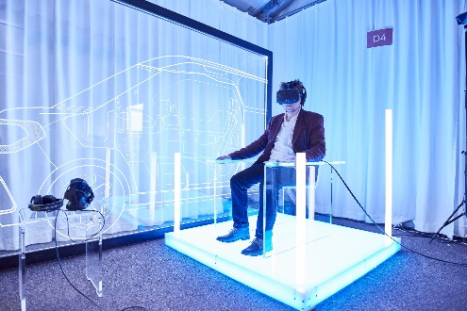
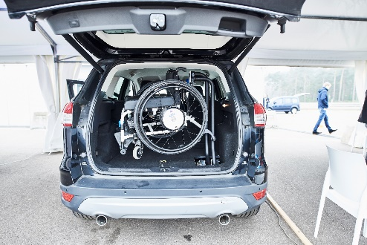
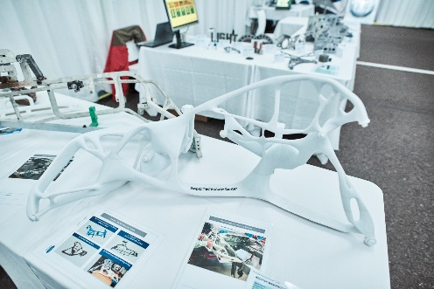
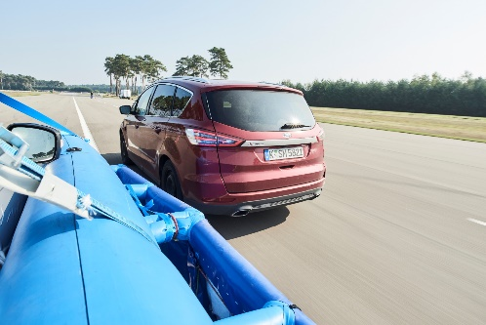
2017 IDTE LPG Video
2017 R&A Innovation Drive & Tech Expo
Sep 25 – 29, 2017

Slide 5
IDTE
ROUTINE FOR EVALUATORS
All evaluators will receive a personalized agenda and concept location maps to experience various technologies in 20 minute increments.
Some static concepts have been combined and the participant will experience all within the 20 minute slot.
Each concept has a one pager with the technology / feature description that will be digitally stored on the evaluator tablet (*no hand outs are provided and will be distributed post event*)
For all technologies, Ford presenters will give a brief talk and demonstration to the participant. Supplier representatives will support for more technical details for their technologies.
At the end of the demo (approx. last 2-3 minutes of 20 minute slot) an electronic questionnaire will be completed to collect relevant opinions on the demonstrated technologies / features.

Slide 6
IDTE
KEY DATES
Setup: Aug 16 -17, 8am - 4pm (Driveable testing can start on the 15th)
Dry-Run: Aug 20, 8am - 4:30pm (Mandatory for all)
Final prep: Aug 21, 8am - 4pm (At the discretion of each presenter)
Event: Aug 22-24 & Aug 27-28, 8am - 4:30pm
Teardown: Aug 28, 4:30pm - 7pm & Aug 29, 8am - 4pm
The setup of demos is required to be complete prior to the dry-run day
Coffee is available during the morning briefing session and during morning/afternoon breaks
Catered lunch will be provided 8/20, 8/22-24 & 8/27-28 (lunch not provided 8/15-17 or 8/21)

Slide 7
SETUP INFORMATION

Slide 8
IDTE
INFO REQUIRED PRIOR TO SETUP
Information which had to be submitted by August 1st
Ford and Supplier Attendance
Ford Presenters – submit to SharePoint
Supplier Representatives – submit information via excel form
One Pager information will be auto-populated from input to SharePoint (Ford only). Suppliers will submit the excel form. Evaluators will be able to access via tablets during event (no printed copies allowed)
Confidentiality form and waiver must be signed prior to entering event grounds (can be scanned and returned to IDTE@ford.com)
Image Capturing Authorization form is required for any technologies that include a camera
Shipping in information
Driveable forms required for admittance to ACM & ACM Track Safety Training for Ford (see slide 19)
If you cannot supply your own target vehicles for the event, please contact Jamel Belwafa (jbelwafa@ford.com)
Notes:
Add word document for Supplier for the confidentiality

Slide 9
IDTE
SHIPPING INFORMATION
Shipping in dates & requested information must be submitted by August 1st.
(Ford submit to SharePoint, Suppliers return excel form to central planner & IDTE@ford.com)
Shipping Address:
ATTN.: Jim Rollison +1 (419) 350-7101
American Center for Mobility
Intertek / Ford IDTE
2701 Airport Road
Ypsilanti, MI 48198
USA
Please ensure that the crates or vehicles are affixed with the attached template so that they can be easily identified
To avoid the label being damaged it is recommended to laminate or put it in a plastic sleeve
Sticker Template

Slide 10
IDTE
OnePager input
Fields for the One Pagers are collected through the attached Excel Sheet and 2 powerpoint templates for the One Pager picture and the Supplier logo.
Please fill in all the fields in the table:
Not all fields will be used to display on the evaluators tablets, but they will be used for the report out of the results after the event, therefore please complete all fields
See next page for some further instructions.
For the picture and the logo, please use the powerpoint size templates (ProjectPicture.pptx for the one pager picture and SupplierLogo.pptx for your company logo) to assure that your picture and logo will fit in the available space on the tablets and PowerPoint one pagers.
Once ready, please save as pptx files
“CompanyName.pptx” for company logo
“ConceptID#.pptx” (i.e. 400.pptx or 400_1.pptx)

Slide 11
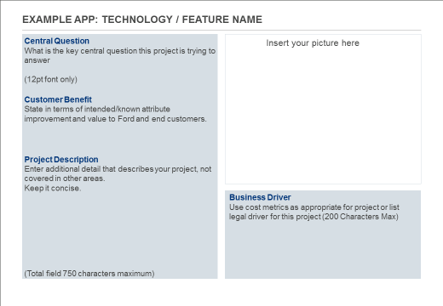
IDTE
OnePager input
The big field on the left consists of 3 fields (2 fields for suppliers) which are collected separately, but should fit into the details field together – MAX 750 characters in total (excluding the headers)!
Central Question (not for suppliers)
Customer Benefit
Project Description
The Business Driver field may be max. 200 characters.
It is easiest to first prepare your text and then copy it to the sharepoint list. Please keep special formatting to a minimum.

Slide 12
IDTE
SHIPPING INFORMATION
Teardown will be August 28, 4:30-7PM AND August 29, 8AM-4PM.
No early teardown will be allowed.
All properties must be carried or shipped out of ACM by 4PM August 29th.
If assistance with shipping is needed, please contact Jamel Belwafa (JBELWAFA@ford.com) during set-up days.

Slide 13
IDTE
ATTENDANCE
Due to the size of the event & general logistics, Ford Presenter & Supplier Representative attendance will be limited per day per concept/technology.
All attendance must be submitted before the event.
Each concept must have ONE Ford Presenter per day. Attendance must be submitted on the SharePoint.
Each SUPPLIER concept can have, in addition to the Ford Presenter, ONE Supplier Representative per day. Attendance must be submitted via the excel form you have been sent.
If Supplier concepts require a target vehicle, you will be permitted one additional supporter per day. The target vehicle driver must receive training from ACM prior no later than August 16th. Please contact Marty Trenkle MTRENKL2@ford.com.
Notes:
Add word document for Supplier for the confidentiality

Slide 14
IDTE
SETUP DAYS
Setup Days: 8am-4pm, Aug 16-17 (driveable testing can start on the 15th)
Please register your name and concept with the IDTE staff near the parking area.
Shipped items will be retrieved from storage by ACM staff. There will be a central contact on site, check at registration for name & contact info.
Supporters are responsible for ensuring their concepts and equipment arrive on time at ACM
Static concept supporters can find designated area to begin setup (see layout)
No banners/posters or advertisements are allowed
Notes:
Need to have registration people for setup week….who???? Have temporary badges (make sure it says Supplier)
Can we have one central person managing getting the shipped items out of the maintenance building?? Intertech Technician???

Slide 15
IDTE
SETUP DAYS CONT’D
Setup Days: 8am-4pm, Aug 16-17 (driveable testing can start on the 15th)
ACM will provide some equipment for setup
A technician will be running a forklift for setup use
Strongly recommend bringing your own basic tools for setup
If you require a 12V battery or charger, you are responsible for providing for your concept.

Slide 16
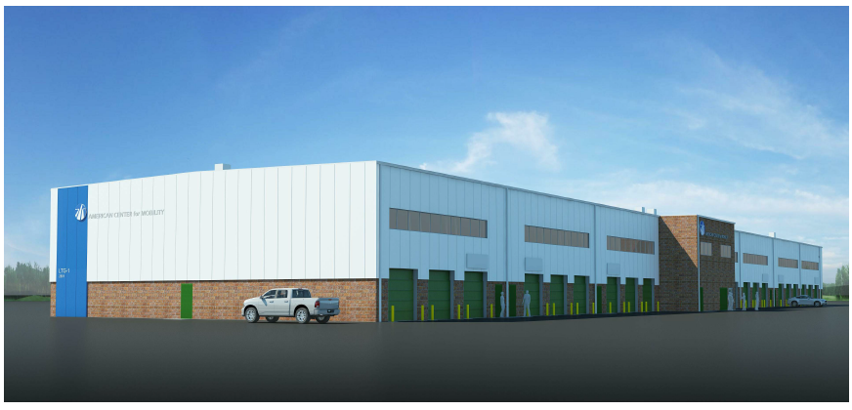
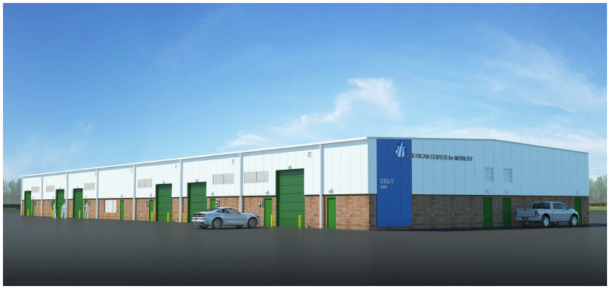
ACM
SHORT TERM GARAGE
LONG TERM GARAGE

Slide 17
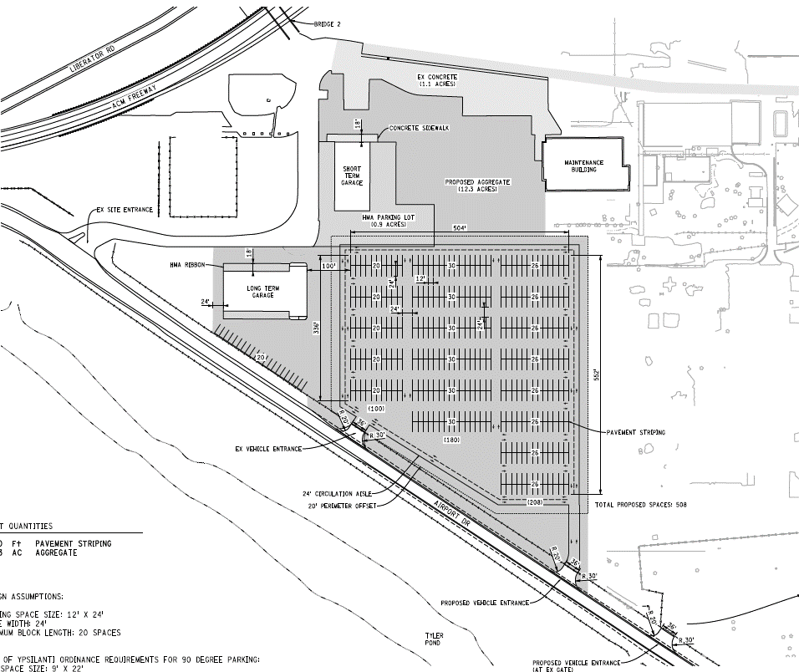
STATIC LAYOUT OVERVIEW
SHORT TERM GARAGE
DRIVABLE VEHICLE STAGING
STATIC VEHICLES
DELIVERY AND VEHICLE ENTRY (SETUP DAYS ONLY)
RESERVED
PARKING & ACCESS TO
REGISTRATION
LONG TERM GARAGE
IDTE EVENT
PARKING
ENTRY

Slide 18
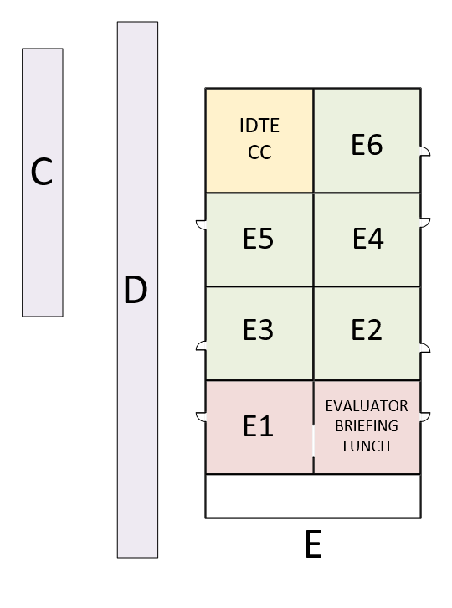
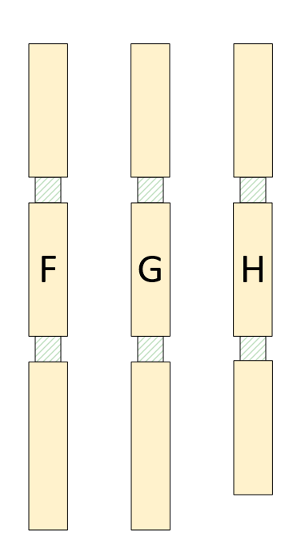
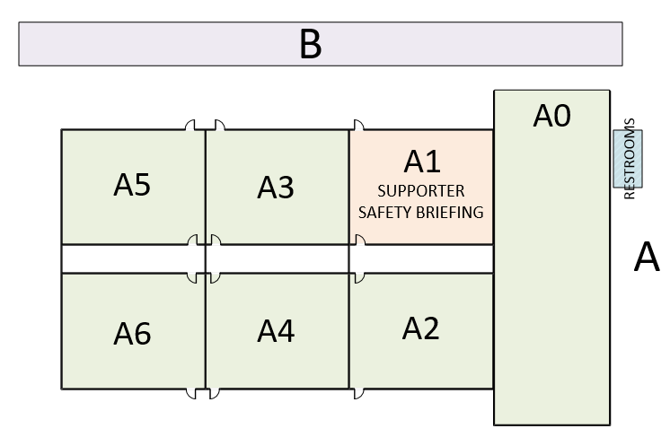
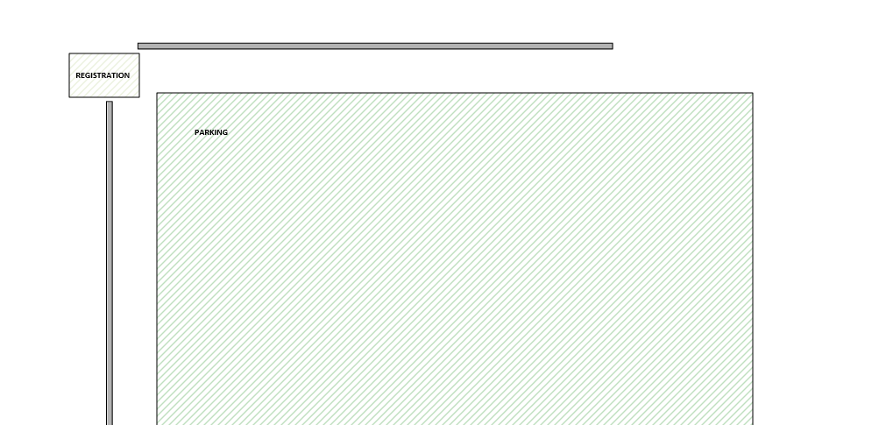
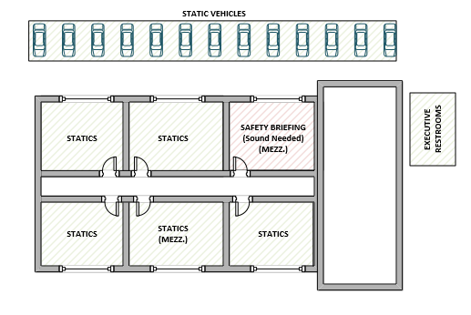
SHORT TERM
GARAGE
TRACK ACCESS
DRIVEABLE VEHICLE STAGING
REGISTRATION / MAIN ENTRANCE
RESERVED PARKING
PARKING
LONG TERM GARAGE

Slide 19
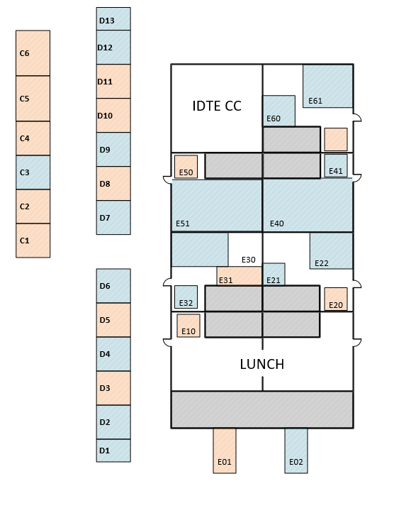
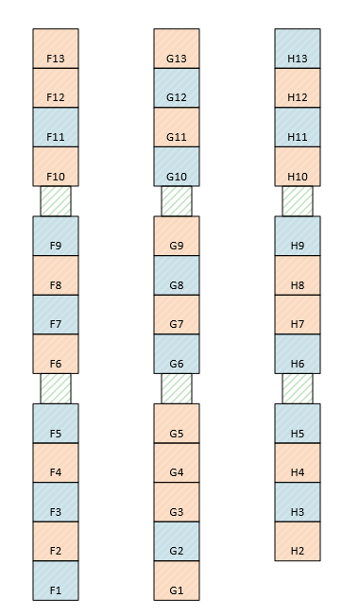
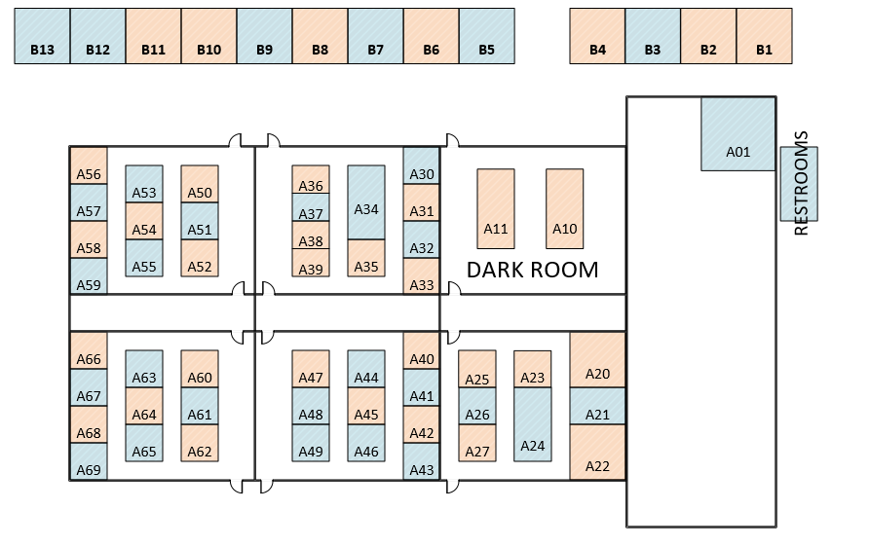
SHORT TERM
GARAGE
DRIVEABLE VEHICLE STAGING
C
B
D
E
H
F
G
A
LONG TERM GARAGE

Slide 20

TRACK ACCESS
Track access prior to the event schedule (scanning/mapping/practice)
All event required documentation (see next page) plus:
ACM user agreement.
(Rates for services and COI details are in the user agreement.)
A copy of your W-9 to setup company in the ACM system.
PO for agreed amount dependent on access requirements (Both Ford & Supplier)
ACM Needs Assessment document with the details of the procedures.
Track tours are available after 3PM every Monday, Wednesday, and Friday. Please contact Marty Trenkle (MTRENKL2@ford.com ) for availability and to schedule a tour.

Slide 21
TRACK ACCESS
Track Access during event (August 15th thru the 28th)
All drivers (SME’s when evaluator is driving) require ACM Track Safety Training
Training is tentatively scheduled for August 10th, 14th & 16th for European (register via Marty Trenkle (MTRENKL2@ford.com)
Group size is limited to 12 persons each.
Sessions scheduled at 8:00 AM and 2:00 PM
All vehicles must have COI: proof of $5M insurance and American Center of Mobility as insured party. (Ford vehicles are covered by corporate level document)
All vehicles must have an inspection checklist completed before they will be allowed on the track surface
All drivers must clearly display the ACM training badges at all times
Each driveable vehicle MUST be equipped with a fire extinguisher

Slide 22
VEHICLE SUPPORT
Keys must be left in all vehicles (static and driving) while on ACM grounds.
FUEL
Unleaded Regular and Diesel Fuel are available at the ACM facility
Any unique requirements beyond this need to be identified.
ACM personnel are required to use fill equipment.
Fueling will generally be done each evening after demos are completed unless needed sooner.
Fuel Need indicators will be provided to let ACM staff know the vehicle needs fuel.
WASHING
ACM will be available to rinse down vehicle exteriors if needed each evening)
Cars will be rinsed and blown dry (exterior only).
Wash need indicators will be provided.
REPAIRS AND MAINTENANCE
Vehicle repairs are the responsibility of the Demo owners
Major repair issues will require Dearborn Technicians to be sent to ACM.

Slide 23
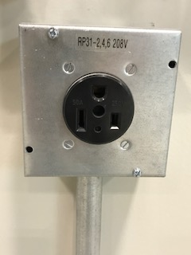
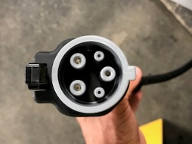
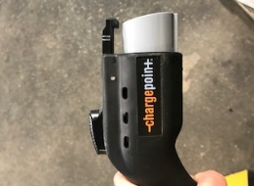
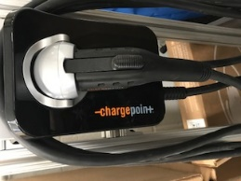
EV CHARGING
Garage vehicle charging and power supplier options:
Portable charging stations:
NEMA 6-50 plug/ 208 3phase
100 amp, 480volt, 3 phase, 4 wire pin and sleeve EV2 charging receptacles
**This will require an adapter to plug into. Please contact your central planner if you need assistance identifying an adaptor
-or-
-or-
110v receptacles
**May need adaptor for vehicles

Slide 24
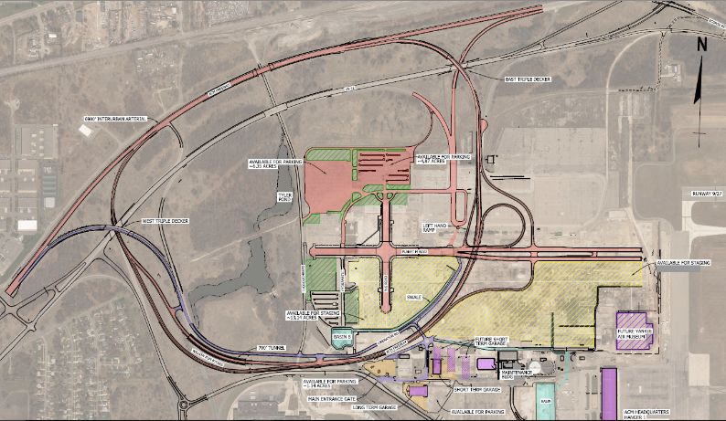
TRACK LAYOUT
Parking Demos
Inter-Urban Arterial
“VDA” Demos
x
On/Off Ramps
6 Lane Intersection
x
6 Lane Boulevard
Access Road
x
x
x
700’ Tunnel
x
x
P
Highway Loop

Slide 25
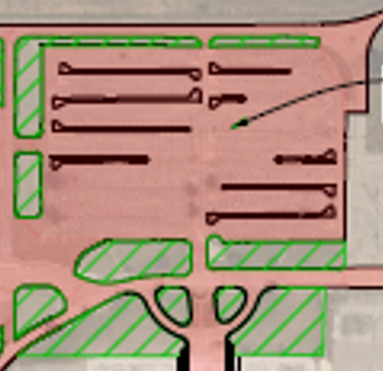
PARKING AREA DEMOS
Newly paved
Angled parking space
Curbed dividers and islands as shown
Moving some to open areas
400
67
400
522
641
654
67
522

Slide 26
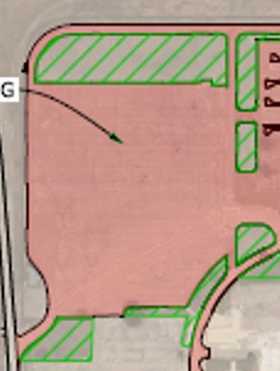


VDA PAD DEMOS
Slalom setup using cones
Low speed
Evasive lane change setup for higher speed with cones
Large area on south end for more defined maneuvers.
3
61
490
544

Slide 27
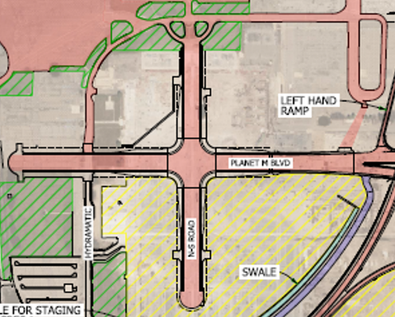
6x6 INTERSECTION DEMOS
Six lanes with protected left turn lanes
Traffic Light controlled
Whole cycle is 60 seconds
Traffic needs to follow all lights
Flow to end of each “street” then turnaround
Tour based demos will stop in these areas.
41
85
149
607
653
709

Slide 28
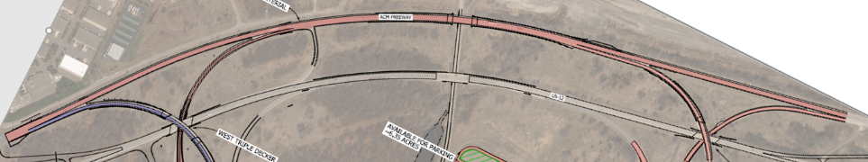
ARTERIAL ROAD DEMOS
Potholes and 1 speedbump
Potholes
Demos will run spaced out but must be aware of existing traffic
Several demos will use potholes as needed
Demo 561 is adding features on exit road.
Demo 94.1 will run additional demo east of barrier beyond exit point
Demo 475 will need extra space (or last) to allow for stops
64
94.1
160
457
475
505
561

Slide 29
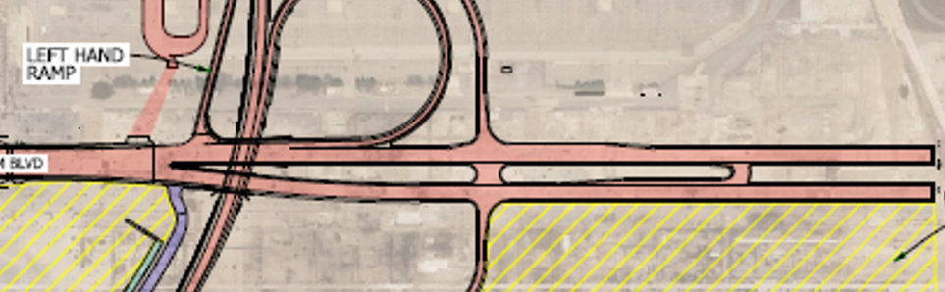

6 LANE BOULEVARD DEMOS
83
128
511
624
661
511 / 661
Entry and Exit Point
128 / 624
511 / 661 Lane change maneuvers performed on North (westbound) Lanes
128 / 624 Truck Lane Change and sway maneuvers performed on South (Eastbound) Lanes
83 to circulate as available
128 to proceed to second demo area south of boulevard

Slide 30
AREA SOUTH OF BOULEVARD DEMOS
Area is smooth plant floor with discontinuities from columns, cracks, filled in patches
Demos moved here needed equipment setup, areas larger than available or smoother surfaces.
128
457
517

Slide 31
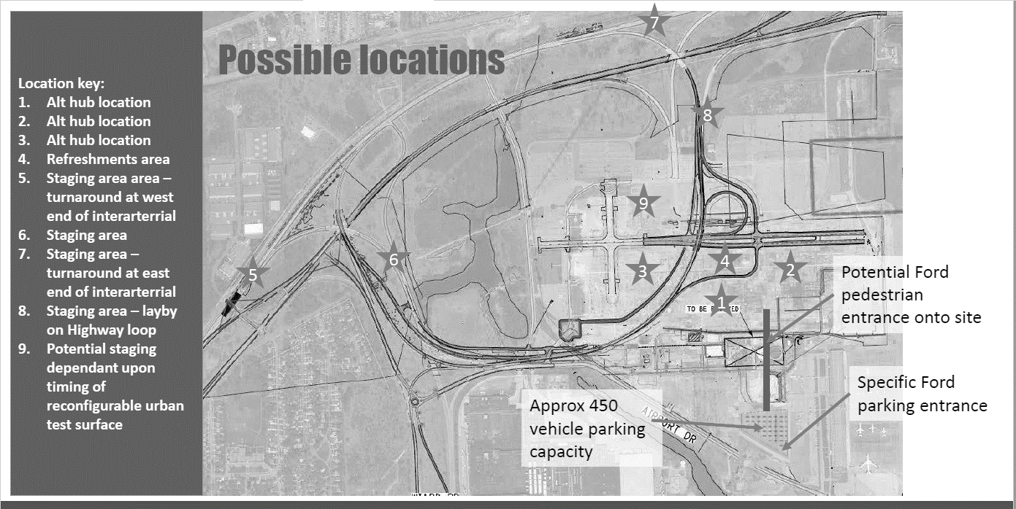
ACMHIGHWAYLOOP DEMOS
Highway loop used for automated lane changes or driving
~2.3 miles
Mostly 2 lane with a 3 lane section.
50mph, 55mph & 65mph
We can modifiy speed limits for our event.
Some have target vehicles
None are allowed to stop on the roadway (there is one lay-by)
Demo 92 is new and needs to be reviewed for another area
4
16
54
65
92
148
401

Slide 32
ACM TUNNEL BYPASS LOOP DEMO
This demo is restricted to this area due to safety issues from unintended stopping and vehicle behaviors.
Gate from ACM Highway will be closed
Demo car will recirculate using the access road.
713

Slide 33
DRY-RUN INFORMATION

Slide 34

IDTE
PARKING AT ACM
Parking for supporters will be limited to 450. Please do not park in area reserved for evaluators.
Registration tents will be set up near the entrance to the track.
Check in will be alphabetically by last name.
Address for GPS (follow IDTE signs onsite):
2701 Airport Road
Ypsilanti, MI
P

Slide 35
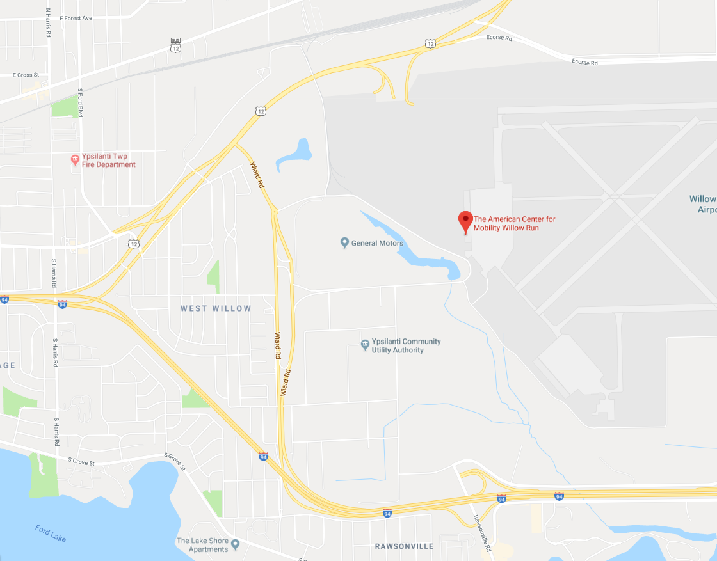
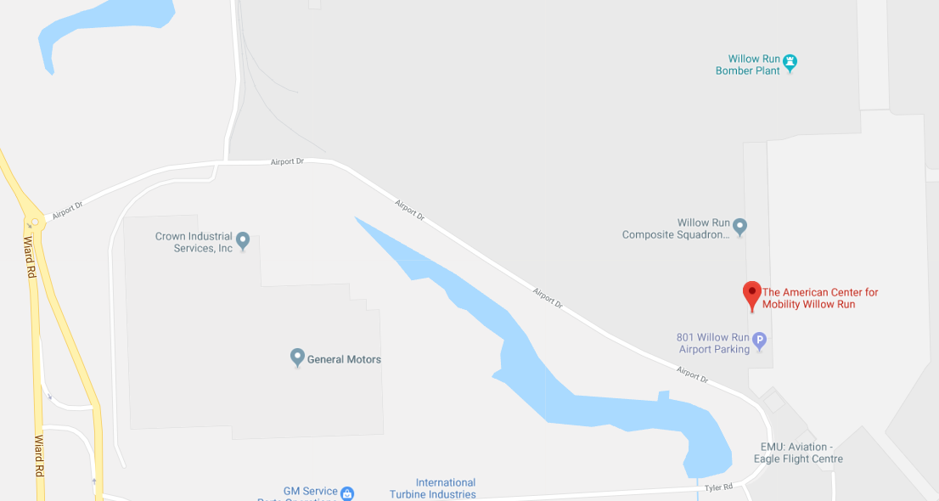
IDTE
PARKING AT ACM
P
Special IDTE Entrance
(follow IDTE signs)

Slide 36

IDTE
REGISTRATION AT ACM
ALL PRESENTERS AND REPRESENTATIVES MUST SIGN IN WITH IDTE STAFF NEAR PARKING ANYTIME YOU ENTER THE GROUNDS
Dry-run and event days sign-in between 8 AM and 9 AM
Confidentiality waivers should be turned in prior to event. Must have one submitted in order to enter the event.
Supplier representatives may carry ONE mobile device and ONE laptop but cannot use any camera features. If you need a picture taken, you can ask a Ford member who has an orange camera pass.
All personnel must make arrangements to exit the event grounds no later than 5 PM each day (set-up, dry run, final prep and event).
You must register your attendance before the event. Walk-ins are not allowed.

Slide 37
IDTE
DRY-RUN DAY AGENDA August 20th
8:00 am Final safety check shipped vehicles – setting up staging area and static demos
9:30 am Overview of event agenda & Safety Briefing by ACM Safety Engineer
10:00 am Hand out of agendas
10:30 am Finish readying concepts & running tests
11:20 am Dry Run – Part 1 (without participants – running all events in parallel))
12:20 pm Feedback on Dry-run
12:40 am Lunch
1:20 pm Dry Run – Part 2: with participants (R&A Management)
2:40 pm Coffee break
3:00 pm Dry Run – Part 3: with participants (R&A Management)
4:20 pm Feedback session with all
MANDATORY for all Ford Presenters and Supplier
Representatives

Slide 38
EVENT INFORMATION

Slide 39
IDTE
REGISTRATION & BADGES
ALL PRESENTERS AND REPRESENTATIVES MUST SIGN IN WITH IDTE STAFF NEAR PARKING ANYTIME YOU ENTER THE GROUNDS
Dry-run and event days sign-in between 8 AM and 9 AM
Receive printed badge on first day of attendance
On subsequent days, present badge upon check-in (missing or lost badges will result in delayed entry to event grounds)
Supplier representatives may carry ONE mobile device and ONE laptop but cannot use any camera features. If you need a picture taken, you can ask a Ford member who has an orange camera pass.
You must register your attendance before the event. Walk-ins are not allowed.

Slide 40
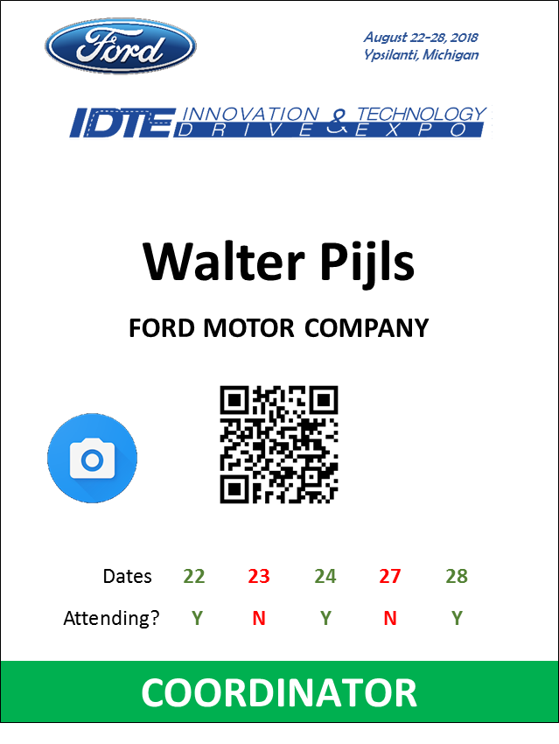
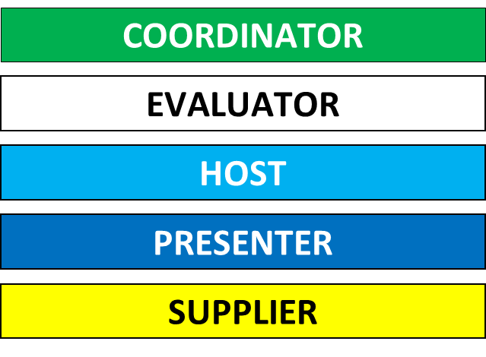
REGISTRATION & BADGES
Badges will be provided on the first day of attendance
Attendance dates are printed on the badge
Check-in is required every morning
Please communicate any change in attendance dates asap with your central planner
At the closing of the event, please recycle the badges in provided bins

Slide 41
IDTE
EVENT DAY ROUTINE
All technology demos will receive a personalized agenda for each day:
Agendas are handed out each morning during the IDTE briefing session
On the agenda will be the name and the role of the person that is scheduled to experience technologies (Evaluator)
If an evaluator is missing for an allotted time slot, check the no-show list posted at various locations throughout the site
Each concept has a one pager with the technology / feature description available on the evaluator tablet
For Supplier driveable and statics there will be an assigned Ford Presenter at all times
An electronic questionnaire will be used to collect relevant opinions on the demonstrated technologies / features
Remind evaluators to complete the questionnaire on tablet at the end of each demo

Slide 42
IDTE
SUPPORTER DAILY EVENT AGENDA
8:00 - 8:45 am Check-in / Registration begins for Supporters (coffee available)
Vehicle Safety Checks & Function Checks
Demo build-up / testing / fueling
9:00 am Daily Briefing for Supporters (Event & Safety)
9:40 am Evaluation Session Block I
11:00 am Coffee break
11:20 am Evaluation Session Block II
12:40 am Lunch
1:20 pm Evaluation Session Block III
2:40 pm Coffee break
3:00 pm Evaluation Session Block IV
4:20 pm End of event day
No handouts are allowed during the event (gifts, trinkets, etc.)

Slide 43
GENERAL SUPPORTER INFORMATION

Slide 44
IDTE
GENERAL SUPPORTER INFO
Dress Code:
Business casual (recommended for Ford: black trousers and white shirt / top)
Hats are okay, Ford hats are preferred for Ford personnel
Closed toe comfortable shoes – no sandals, no high heels
Be prepared for inclement weather (rain, cooler weather, etc.)
Sun screen is recommend for those who are stationed outdoors
Lunch:
A simple boxed lunch will be provided August 20, 22-24 & Aug 27-28

Slide 45
IDTE
EMERGENCY PROCEDURES
When either an audible fire alarm or an alert using two-way radios provides an emergency notification, all participants shall stop any presentation and demo and follow one of the following procedures:
For NON-Evacuations, a tornado shelter or refuge defined as a safe location for protection in an emergency. These locations have been identified as:
For drivable vehicles: return immediately to seek shelter at the Maintenance Building – South East corner of the building
For static vehicles/displays: proceed to the Short Term Garage or Long Term Garage – Central part of buildings
Facility Evacuation, in the event a facility evacuation is needed for a variety of Emergency conditions such as a Fire, Severe Weather, or a bomb threat, evacuate the building and proceed to one of two following assembly points:
Long Term Garage, North East Corner of the Parking Lot.
Short Term Garage, North West Corner of the Parking Lot.

Slide 46
IDTE
MEDICAL EMERGENCY PROCEDURE
Minor Injuries or bleeding
Immediately notify ACM Operations member Intertek Shirt, Yellow Safety Vest or a member of the IDTE Coordination Team (yellow jacket).
Chest pain, difficulty breathing, or stroke-like symptoms
ACM Radio, Channel 1 “ACM EMERGENCY CHANNEL”
419-350-7101, Jim Rollison, ACM Operations Manager
517-898-9429, Dennis Winslow, ACM Track Manager

Slide 47
IDTE
TABLE OF CONTENTS
GENERAL EVENT OVERVIEW
2017 video
Overview
Evaluators Routine
Key Dates
SETUP INFORMATION
General info
INFO REQUIRED by Aug 1st
Shipping information
Info needed from supporters
What ACM will provide
Static layout
Required driveable forms
EV Charging
Driveable layouts
DRY RUN INFORMATION
Parking
Registration
Detailed Agenda
EVENT WEEK INFORMATION
Registration & Badges
Detailed Supporter Agenda
Detailed Evaluator Agenda
GENERAL SUPPORTER INFORMATION
Event Reminders
Things to Do
Emergency Procedure
Medical Emergency Procedure
FAQS
IDTE CENTRAL PLANNERS

Slide 48

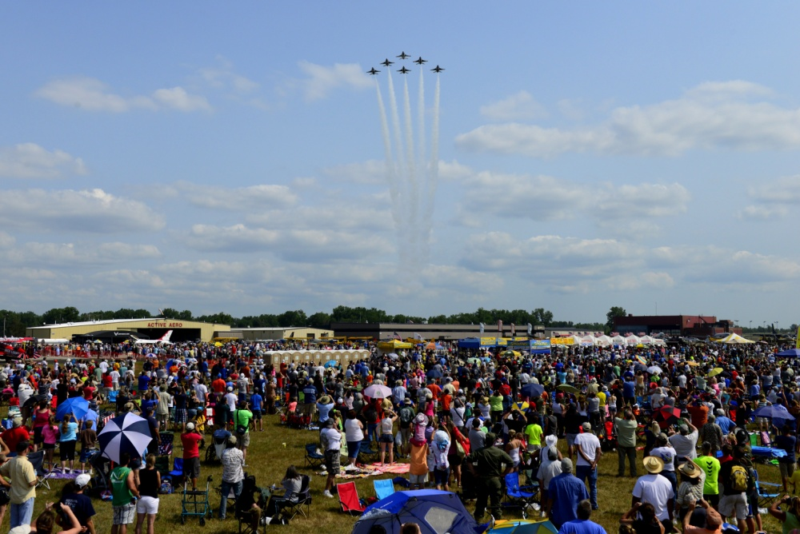
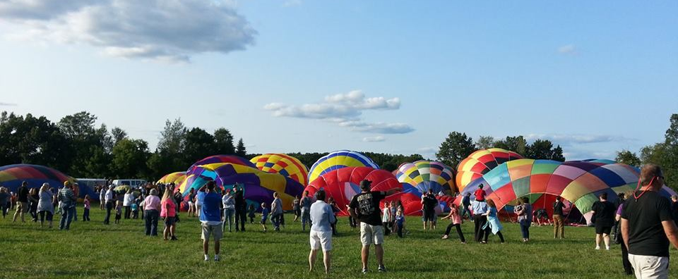
IDTE
THINGS TO DO
WOODWARD DREAM CRUISE
THUNDER OVER MICHIGAN AIRSHOW
METAMORA COUNTRY DAYS AND HOT AIR BALLOON FESTIVAL

Slide 49
IDTE
FAQ’s
Who presents supplier technology demos (including statics & drivables)?
A Ford Presenter. The supplier Representative will support and help answer questions.
Who drives the drivable technologies?
The Evaluator drives the vehicle to experience the technology (a few exceptions).
Who rides in the passenger seat in a supplier drivable technology?
The Ford Presenter who will be giving the presentation and is informed on the safety protocols on the test track. The supplier Representative will ride in the vehicle to provide support to the Ford Presenter.
When do we find out who we are presenting to?
Supporters will receive an agenda with their Evaluator information each morning at the supporter briefing.
Are Suppliers allowed to look at all the other technologies?
No, due to confidentiality and security reasons, this will not be permitted.
Each supporter will have identifiers on their name badge as to Ford vs. Supplier.
Will Ford Intranet be available and only for demos
There will be limited availability. Please communicate your needs via the SharePoint request form, and consult with your central planner.

Slide 50
IDTE
FAQ’s
Who is responsible for preparing concepts for shipping to / from ACM?
Concept owners are responsible for packing their properties and all supporting items.
Shipping coordinators assist with understanding the process, communicating with Central Planners and Presenters
Shipping coordinators will not pack concepts or supporting items.
Who is responsible for preparing concepts for return shipping after the event?
Ford Presenters / Concept owners are responsible for packing their properties and all supporting items.
Shipping coordinators assist with understanding the process, communicating with Central Planners and Presenters
Shipping coordinators will not pack concepts or supporting items.
Teardown & shipping prep will occur on August 29.
Is anyone able to attend the IDTE?
No. Due to the confidential nature of the technology demonstrations, facility safety guidelines, as well as the timing of demonstrations (20 minutes each), only those Presenters and support personnel necessary to represent the specific technologies are permitted at ACM during IDTE.
Supporters attending should be on their respective Supplier and Ford supporter attendance file. Contact your central planner to confirm that you are listed (email will be sent to suppliers informing about the same)
Evaluators are selected by management and sent a personal invitation.

Slide 51
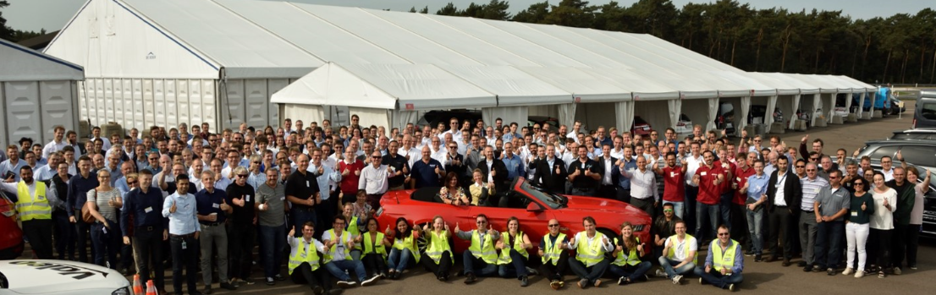
IDTE
We can‘t wait to see you in August!

